Slide 1
BASSic User Manual
SYDE 361 – Final Report
David Ramón Prados

Slide 2
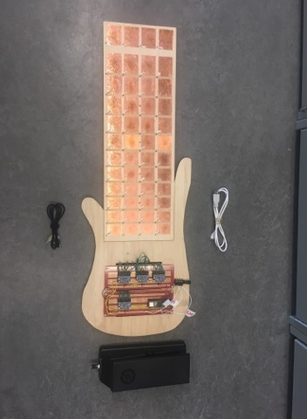
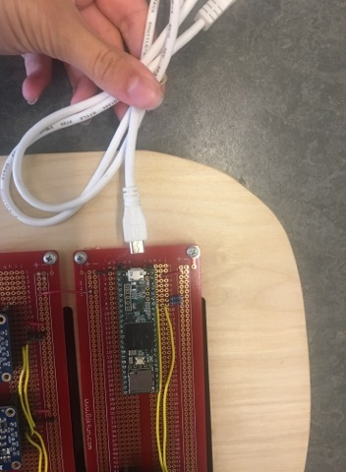
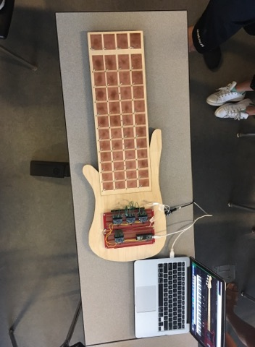
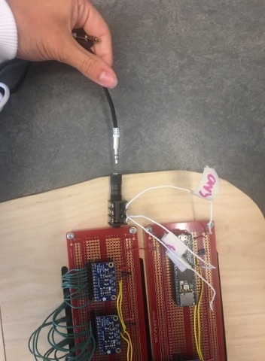
BASSic User Manual – 1. Quick Set Up
SYDE 361 – Final Report
David Ramón Prados 20695485
Congratulations on your BASSic purchase! We hope you love it as much as we do. If you have any questions, you can reach us by phone at 1-800-505-5305 or by email at support@bassic.com.
components pic
5 Step - Quick Set Up:
Download any MIDI capable synthesizer on your computer. We recommend using Ample Sound Host.
Connect the BASSic to your computer using the white micro-USB cable.
Select MIDI as the input source in the Synthesizer, and choose bass guitar as the instrument.
Connect the Pedal to the Audio Jack in the BASSic using the black stereo cable.
Start Playing!
Black Stereo Cable
Volume Control Pedal
BASSic
Audio Jack Input
White micro-USB Cable

Slide 3
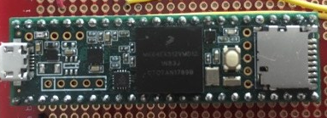
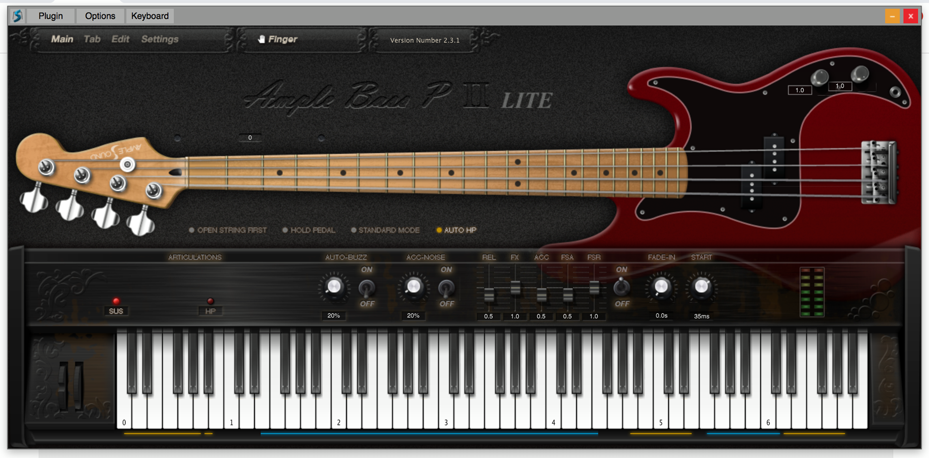
2. Components Information
2.1 What comes in the box?
BASSic instrument
White micro-USB cable
Black stereo cable
Foot Pedal
2.2 What does not come?
MIDI capable synthesizer (required)
Most PCs can run the open source synthesizer Ashost.
Speaker and Aux cord to connect it:
We recommend using an AUX cord instead of Bluetooth connection.
2.3 In case of Malfunction
For the micro-USB or stereo cable:
Replacements can be found in most hardware stores or on amazon.
For the pedal (if out of warranty):
Can be purchased on our website.
Anything else related to the BASSic:
Reset the BASSic by pressing the white button on the green chip:
If the issue is not resolved, or it is due to hardware malfunction, please ship the instrument back to us.
2.4 Contact Information
BASSic Headquarters:
Phone: +1 800-505-5305
Email: support@bassic.com
Address: 201 Spain St, Waterloo, ON, N2L 3R3, Canada

Slide 4
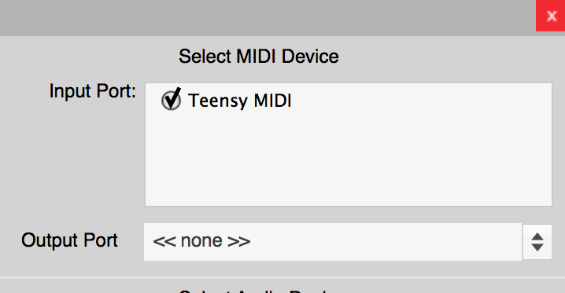
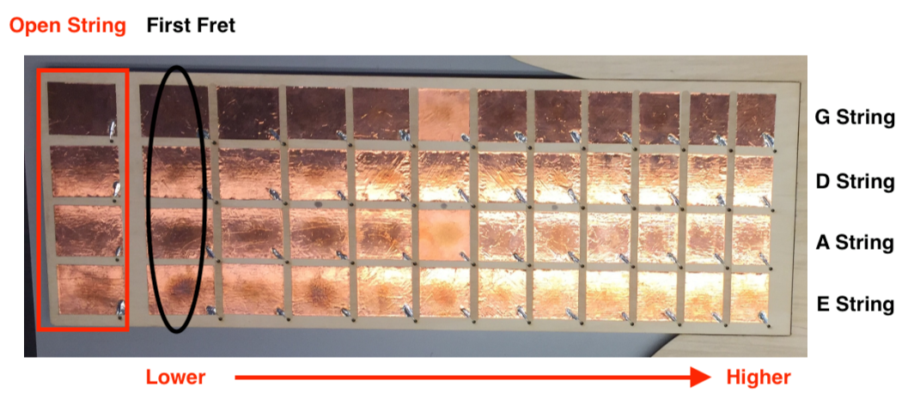
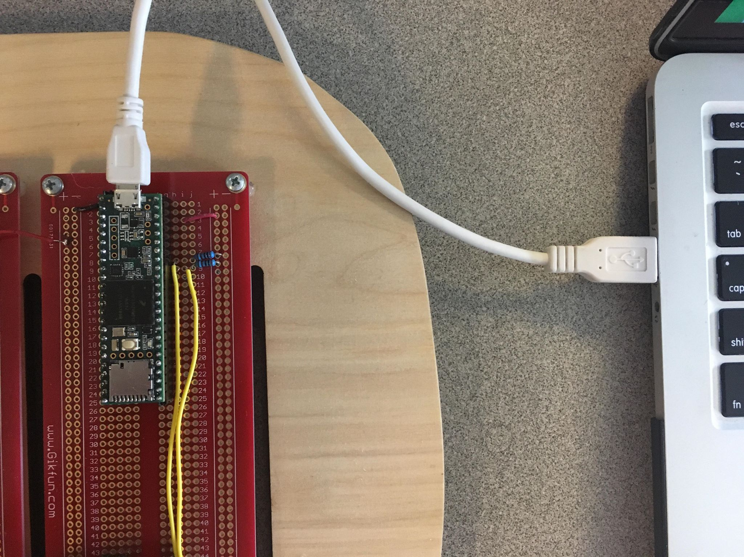
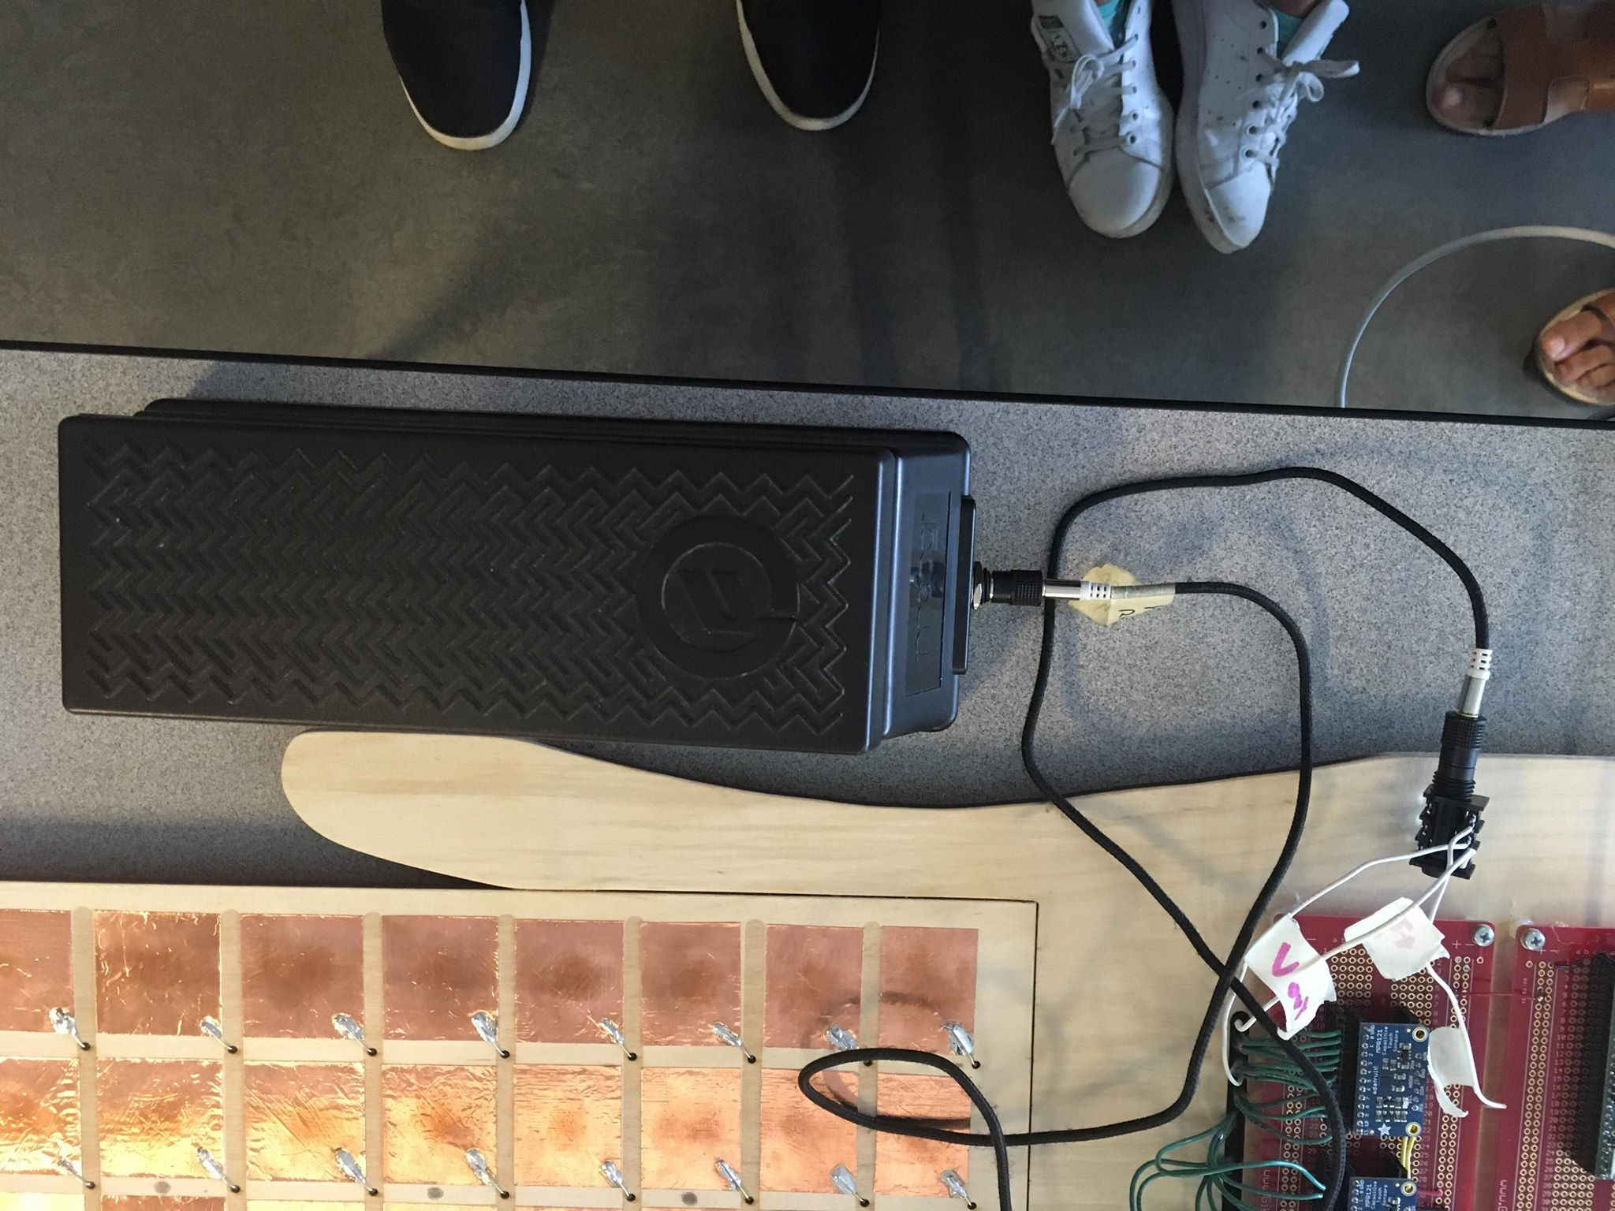
3. Detailed Instructions
3.1 Installation
MIDI Capable Synthesizer Set Up:
With your computer go to Ample Sound Host.
Click Download and Install it.
Select Bass Guitar as the instrument and Teensy MIDI as the MIDI device:
BASSic Set Up:
Connect micro-USB to your computer and the BASSic:
Connect the Pedal to the BASSic with the Stereo Cable:
3.2 Connection to Real Bass Guitar
Instead of strings, the BASSic uses touch-sensitive pads.
Each row is a string: E – A – D – G starting from the bottom (see image below).
Each string has 12 notes making one octave.
Open string is the left-most pad of the row, with different spacing.
Picture with all the info

Slide 5
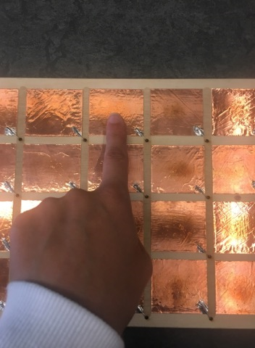
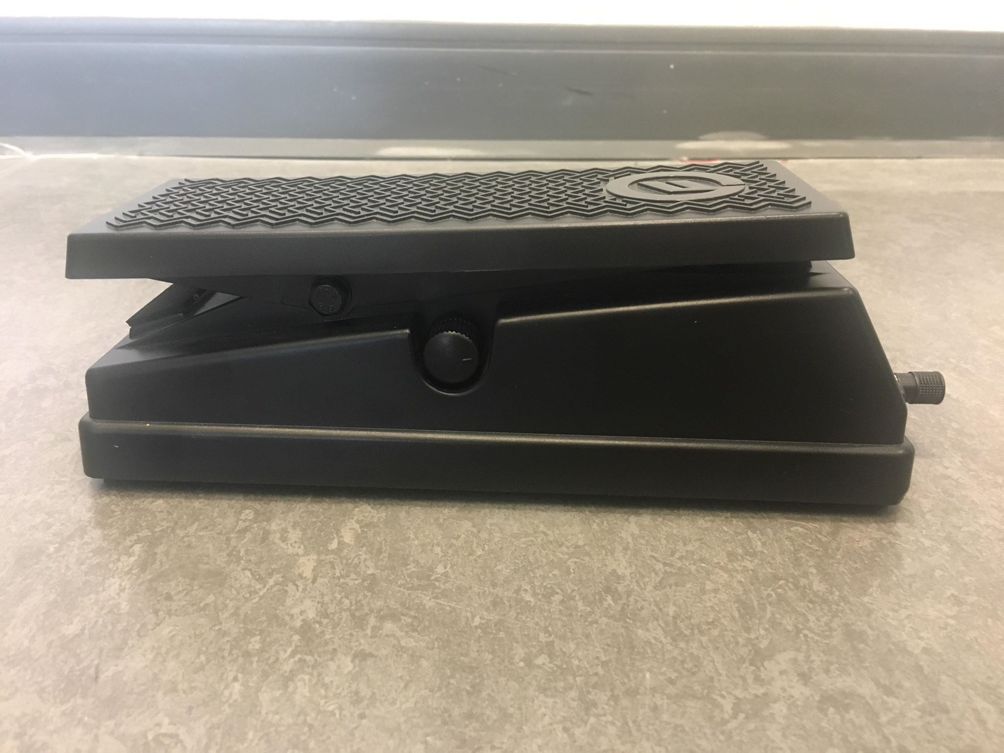
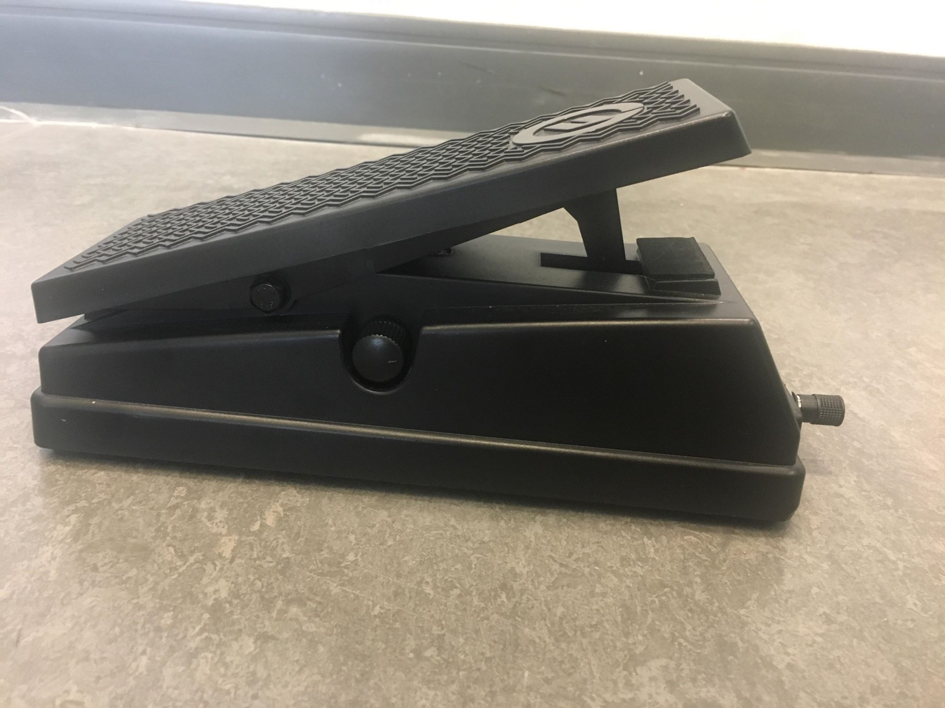
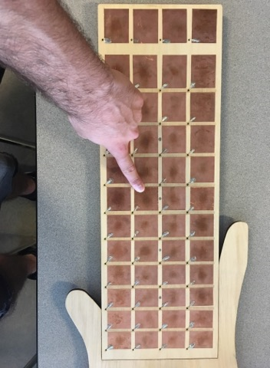
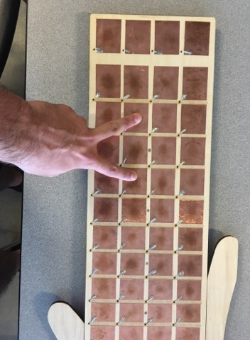
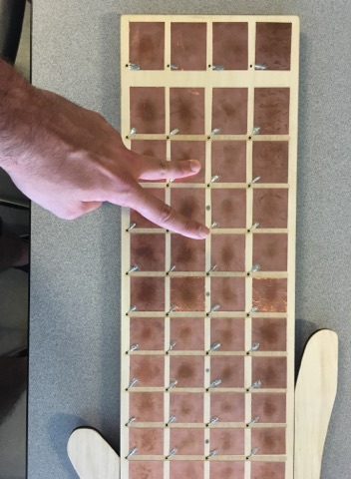
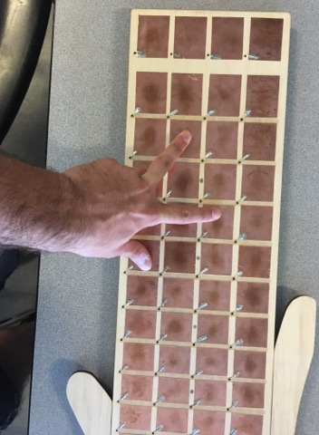
3. Detailed Instructions
3.3 How to Play
Plucking
Touch the pads.
Tuning
The BASSic does not need to be tuned!
Sliding
Slide your fingers between any consecutive pads in the same row. Both directions work!
Chords
Touch one pad from two or more rows simultaneously.
Volume Adjustment
Use the foot pedal: down for higher volume, up for lower:
Pull Off
Press two notes in one row, then release the higher one.
Hammer On
Press one note, then press a higher one in the same row.
Muting
Release the selected note, and it turns off.
Volume Up
Volume Down

Slide 6
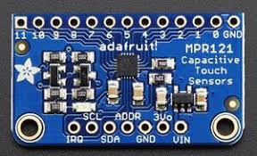
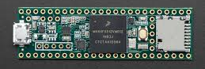
4. How it Works?
The BASSic uses a Musical Instrument Digital Interface (MIDI) in conjunction with four capacitive touch sensors (MPR121) and one microcontroller (Teensy 3.5) to recreate a bass guitar:
The way it works can be outlined in a simple 5 step process:
Any input* by the player is detected by the capacitive touch sensors. The copper pad capacitance drastically drops when touched, and the MPR121 is able to detect it.
*For the foot pedal the input is detected directly by the microcontroller, not the capacitive touch sensor. The pedal is very sensitive and thus only changes in volume which exceed a defined threshold are processed.
The underlying algorithm in the microcontroller reads the change in state of the sensors and interprets the user’s input (plucking, sliding, hammer on…).
The input gets translated into an appropriate USB-MIDI message such as:
Send Note On/Off: MIDI message that requires the note, velocity (set to 120/0) and channel.
Send Pitch Bend: MIDI message that requires the value and channel. Small increments are sent until the target value is reached.
Send Control Change: MIDI message to manipulate any control input. It requires a type (7 for volume), value, and channel.
The MIDI message gets sent to the MIDI capable synthesizer on the PC via the micro-USB.
The synthesizer receives the MIDI input and executes it producing the expected output.
MPR121 [1]
Teensy 3.5 [2]

Slide 7



5. Safety Remarks
[3]
Caution! The BASSic contains electrical components:
Do not attempt to modify the circuitry, in case of malfunction contact us first.
Keep the instrument away from water at all times.
Do not touch the wires when the BASSic is plugged in, it may lead to electrical shock.
If the electrical equipment emits smoke or a burning smell, shut the instrument off, and call technical support.
Inspect the wires and cords regularly. Replace the stereo and micro-USB cables immediately if damaged.
Always unplug the equipment when not in use.
Always be safe!
Do not let children under 12 play the instrument without supervision.
Make sure to take regular breaks to avoid overexerting yourself.
If you experience any sickness while playing the instrument, stop immediately and consult with your doctor.
6. References
[1] "Adafruit MPR121 12-Key Capacitive Touch Sensor Breakout Tutorial", Adafruit Learning System, 2019. [Online]. Available: https://learn.adafruit.com/adafruit-mpr121-12-key-capacitive-touch-sensor-breakout-tutorial/downloads. [Accessed: 28- Jul- 2019].
[2] "Teensy 3.5", Media.digikey.com, 2019. [Online]. Available: https://media.digikey.com/pdf/Data%20Sheets/Sparkfun%20PDFs/DEV-14055_Web.pdf. [Accessed: 28- Jul- 2019].
[3] "WHMIS 2015 Labels", Ccohs.ca, 2019. [Online]. Available: https://www.ccohs.ca/products/posters/whmis_2015_labels/?url=/products/posters/whmis_2015_labels/. [Accessed: 29- Jul- 2019].

